Slide 1
Research Methodology CS 5001 Instructor: Dr. Ramoza Ahsan

Slide 2
Quantitative vs Qualitative Research

Slide 3
Quantitative vs Qualitative Research
Research methods come to two basic types: qualitative and quantitative
Quantitative (indicating that the data collected is in numerical form) and qualitative (indicating that the data collected is not in numerical form).
Often discipline determines which one:
Quantitative – the sciences, as most experimental data results in numerical data.
Qualitative – the humanities and social sciences (including law), as most data worked with is textual or informational, and not quantitative.

Slide 4
Quantitative vs Qualitative Research
Over time, the social sciences and humanities have started to include quantitative methods as well, introducing a new category called mixed methods.
This refers to a mixture of both qualitative and quantitative methods being used in the research.

Slide 5
Quantitative vs Qualitative Research
Qualitative research explores experiences and meanings through non-numerical data like interviews, and observations.
Qualitative research is interpretive (making sense of what’s happening). Most analysis is done in words
Quantitative research measures variables and tests theories using numerical data like surveys and experiments.

Slide 6
Qualitative Research
Focus: Exploring, understanding, and interpreting experiences, meanings, and perspectives.
Data: Non-numerical data like text, audio, video, and observations.
Methods: Interviews, focus groups, observations, case studies, and textual analysis.
Analysis: Interpretive, thematic, and narrative analysis.
Goal: To gain a deep understanding of a phenomenon, often in a natural setting.
Sample size: Typically smaller, focusing on in-depth exploration.
Example: Studying the lived experiences of individuals with a specific illness through interviews.

Slide 7
Quantitative Research
Focus: Measuring, quantifying, and testing relationships between variables.
Data: Numerical data that can be statistically analyzed.
Methods: Surveys, experiments, statistical analysis.
Analysis: Statistical methods like t-tests, ANOVA, and regression analysis.
Goal: To test hypotheses, establish relationships, and make predictions.
Sample size: Typically larger, allowing for generalization to a broader population.
Example: Testing the effectiveness of a new drug through a controlled experiment.

Slide 8
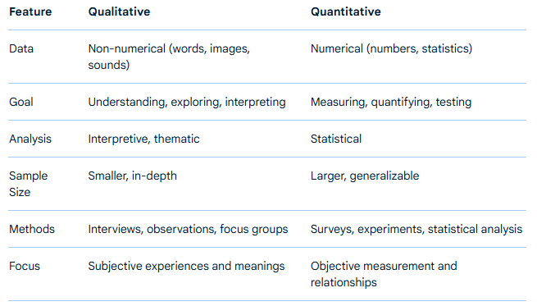
Key Differences

Slide 9
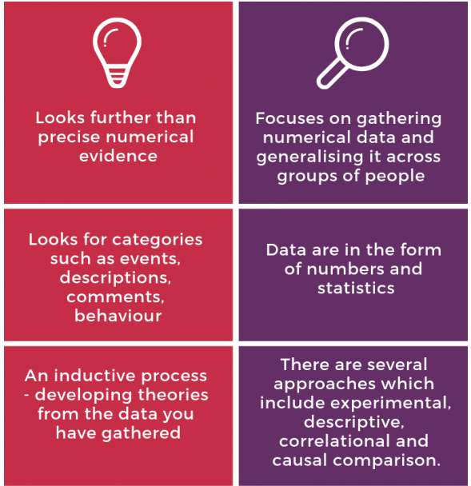

Notes:
https://blogs.sun.ac.za/libraryresearchnews/2019/01/31/research-methods-qualitative-vs-quantitative/

Slide 10
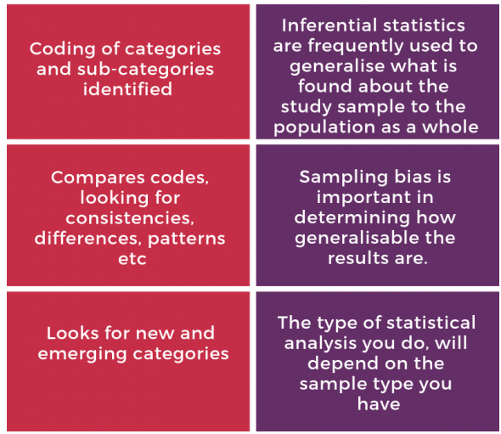
Notes:
https://blogs.sun.ac.za/libraryresearchnews/2019/01/31/research-methods-qualitative-vs-quantitative/

Slide 11
Types of Qualitative Research

Slide 12
Interviews
Generally referred to as a conversation with a purpose
Interested in gaining an individual’s interpretation of an issue
Differs from a conversation in that there is a research purpose,
a structure, a method of capturing the responses and a process for analyzing the responses

Slide 13
Focus Groups
Interviews with a group of individuals (6-8 is the optimum size)
Can be more or less structured in the format of the questioning
Facilitation of the group discussion by the researcher is key
Importance of group dynamics – both positive and negative – that effect the process
Observation of the process is as important as the spoken contribution

Slide 14
Documentary Analysis
Various types of documents produced in social life – professional records, newspaper stories, diaries.
Often intended as objective statements of fact but are socially constructed
There is the surface meaning (of what is said) and the underlying meaning (of what is intended)

Slide 15
Ethnographies
Observational field work done in the actual context being studied
Focus on how individuals interrelate in their own environment (and the influence of this environment)
Difficult to interpret/analyze
Time consuming/expensive
Can influence subject behavior

Slide 16
How to appraise Qualitative Research
Notes:
Assess the quality of research
Example: https://youtu.be/vn5qhORY7fY

Slide 17
Key Questions
Is there a clear research question being posed:
How do female victims of domestic violence make sense of the response of the police to their situation?
Is a qualitative methodology appropriate?
Is the particular qualitative method (eg interviewing, documentary analysis, observation) fit for purpose?

Slide 18
Key Questions
Has the researcher used an appropriate method and sample?
Do the findings link to the data?
Are the inferences and conclusions drawn by the researcher logical?
Have the categories of findings been appropriately constructed?
What is the degree of researcher bias and is it clear what checks have been put in place to deal with these?
What strategies have been employed to increase the credibility of the findings?

Slide 19
Questions about the sample
There is a need to ensure that the subjects being studied are appropriate to the research question:
Would you interview female victims of domestic violence or police officers?
How many individuals/groups/situations need to be studied to make the findings generalizable?
How are the participants in the research recruited and might this bias the findings:
Do you interview victims who have never contacted the police? Or only those where the police have prosecuted the perpetrator?

Slide 20
Quantitative Research
According to Aliaga and Gunderson (2000) quantitative research attempts to explain things
‘by collecting numerical data that are analyzed using mathematically based methods (in particular statistics)’.
The important distinction is that quantitative data needs to be numerical (otherwise it can’t be analyzed)

Slide 21
Quantitative Research
As such there are some questions that are particularly suited to collecting numerical data –
How many people in the population have a diagnoses of diabetes?
What is the average mark of students enrolled on post-graduate courses at QUB or Ulster?

Slide 22
Quantitative Research
There are also types of data that aren’t naturally numerical, but we can transform them e.g.
E.g. questionnaires that ask people to rate their mood on a number of statements (e.g. ‘strongly agree’, ‘agree’, ‘disagree’ or ‘strongly disagree’). Each statement may be assigned a number from 1 -4)

Slide 23
Advantages of quantitative approaches
Sometimes we need to answer population level questions (e.g. how many of those in care have experienced trauma?)
Sometimes we need to test a hypothesis (e.g. if X engaged in Y their outcomes would improve by Z%
Sometimes we need to know the link between to things (e.g. diet and disease)

Slide 24
Types of Quantitative Research

Slide 25
Survey using questionnaire
Relatively cheap to administer; if completed with a researcher can confirm or clarify questions
May restrict number of respondents; can exclude some of the population e.g. those without phones, those who can’t communicate verbally etc.

Slide 26
Existing Databases/datasets
Secondary data-relatively cheap; study can review existing large data sets
Coding may have already taken place; you are not responsible for issues around data collection

Slide 27
Experiments
An experiment is where the researcher intervenes to change something (e.g., gives some patients a drug) and then observes what happens.
Example: Researchers would randomly assign participants to either a control group (receiving a placebo) or an experimental group (receiving the drug) and then measure a specific outcome, like blood pressure readings, after a certain period. The results would be statistically analyzed to determine if the drug has a significant effect on the outcome.

Slide 28
How to appraise Quantitative Research
Is a quantitative methodology appropriate?
Is the particular quantitative method (eg experiment, survey, interviewing, database) fit for purpose?
Has the researcher used an appropriate method and sample?
Do the findings link to the data?
Are the inferences and conclusions drawn by the researcher logical?
Have the findings been appropriately analyzed?
What is the degree of researcher bias and is it clear what checks have been put in place to deal with these?
What strategies have been employed to increase the credibility of the findings?

Slide 29
Assessing Methods
Research Question(s) is/are key
Methods must answer the research question(s)
Methodology guides application
Epistemology guides analysis
All must include “rigor”
Notes:
limits of human knowledge

Slide 30
Case Scenario
Test your research savvy with the following case. Assume that you are the Mayor of Greenwood, a small town in Illinois, and you’ve got to make a decision based on the information collected from the following research study.

Slide 31
Crime Reduction Program, City of Greenwood
The chief of police wants to experiment with increasing the number of patrol officers (X) to reduce the crime rate (Y).
The chief invites all twelve area captains to participate in the experiment; only the 103rd volunteers.
In October, patrol officers in the 103rd are increased by 15%.
Reported crime drops 5% between September & December. The chief now wants to implement the program citywide.

Slide 32
You are the mayor. Would you support this request based upon the results of this study?
Could severe weather in November and December have caused the crime rate to decline?
Is crime seasonal, peaking in the summer and declining in the winter?

Slide 33
More Problems
Since the captain of the 103rd volunteered for the program, could he have already implemented other programs that account for the decline in crime?
Since the officers in the 103rd knew they were involved in a priority program, is it possible that they recorded reported crime differently?

Slide 34
More Problems
Will the crime reduction impact last very long?
Could random error in the measurement of the crime rate account for the difference?
Was the crime rate in the entire city going down anyway?

Slide 35
Thank you
Questions?

